Slide 1
Predicting Diabetes
Lydia Bartnick
Anna Collawn
Gil Fernandez
Jared Sletto

Slide 2
Overview
This dataset analyzes the health of 754 individuals.
The data analyzes the following fields:
Age
Blood Pressure
Diabetes Pedigree Function
F1
Glucose
Insulin
Number of Pregnancies
Skin Thickness
We used a Random Forest model to help predict the accuracy of what are the odds of a individual having diabetes based on the outcome of each of the fields above.

Slide 3
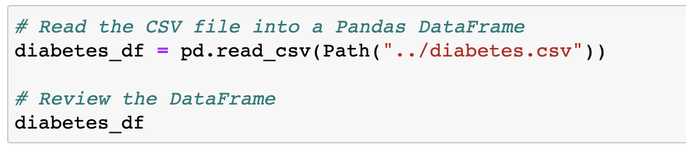
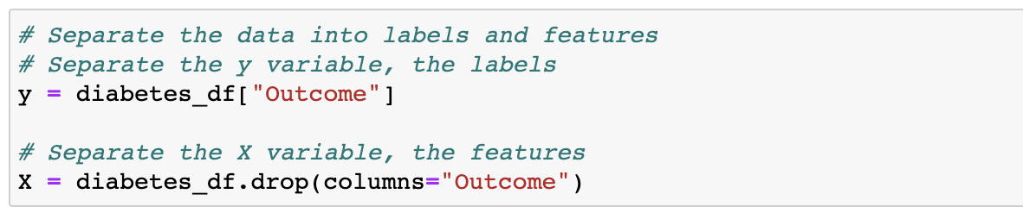
preparing the data pandas

Slide 4
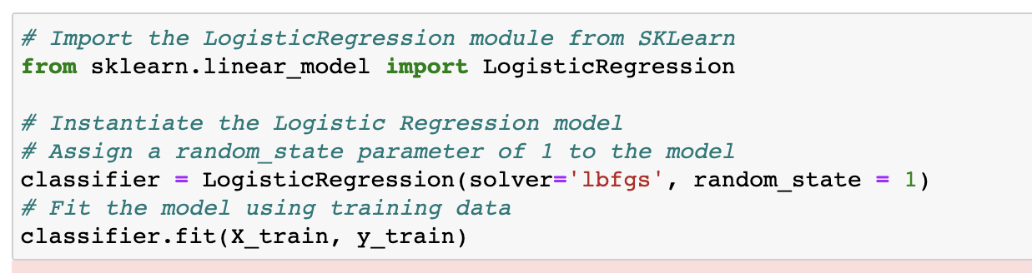
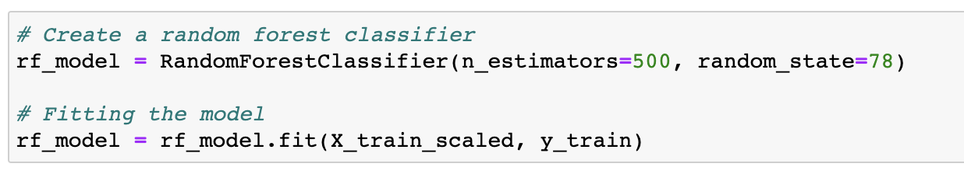
Our Models
Logistic Regression Model
Random Forest Model
Notes:
Logistic regression is a statistical method for predicting binary outcomes from data.
Random Forest Algorithm the random forest algorithm samples
the data and build several smaller, simpler decision trees.

Slide 5
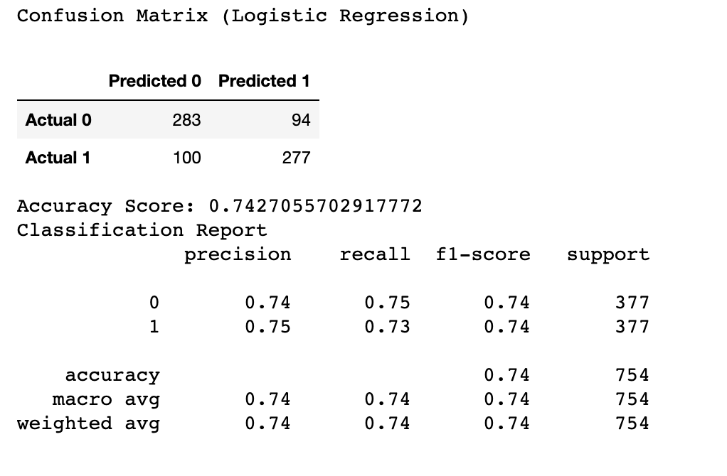
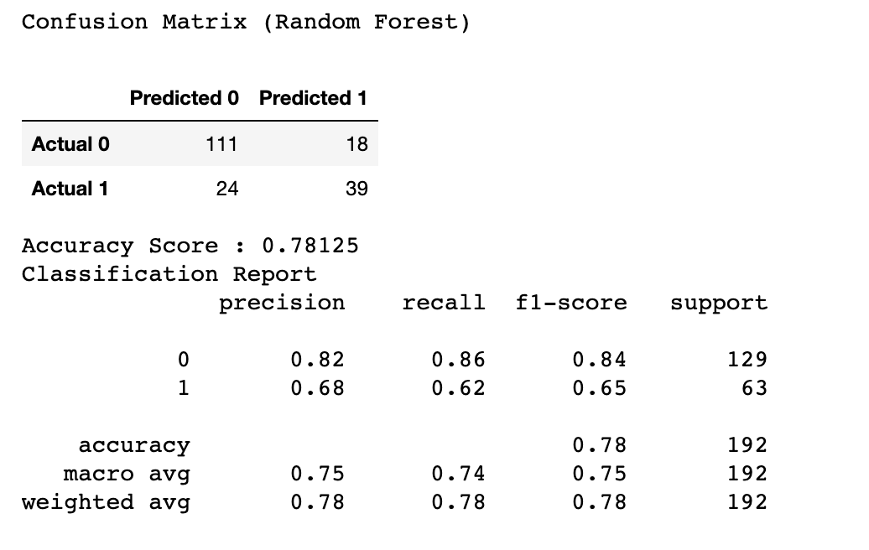
Optimized logistic regression model.
First random forest model.
Notes:
Accuracy, precision, and recall are especially important for classification models that involve a binary decision problem. Binary decision problems have two possible correct answers: True Positive and True Negative.
We use a confusion matrix to measure and gauge the success of a model.
Accuracy is how often the model is correct—the ratio of correctly predicted observations to the total number of observations.
Precision is the ratio of correctly predicted positive observations to the total predicted positive observations.
(i.e., of all the samples classified as having diabetes, how many actually have diabetes?)
Recall is the ratio of correctly predicted positive observations to all predicted observations for that class.
(i.e., of all of the actual diabetes samples, how many were correctly classified as having diabetes?)

Slide 6
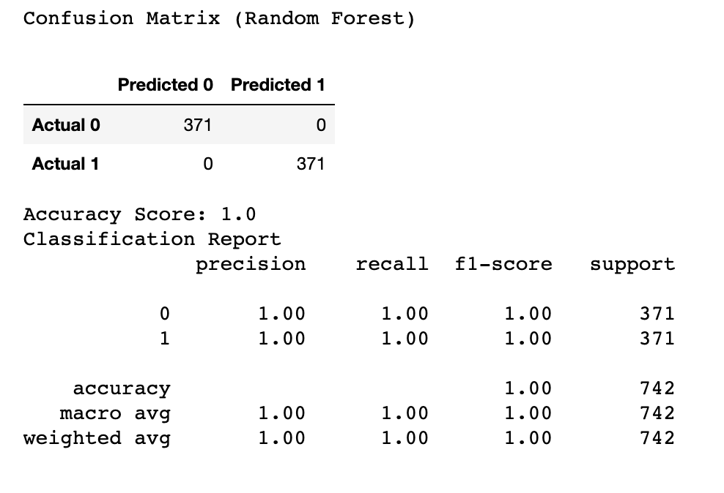
Final outcome
Based on the diabetes.csv data, this random forest model is able to predict if someone has diabetes of not with 100% accuracy

Slide 7
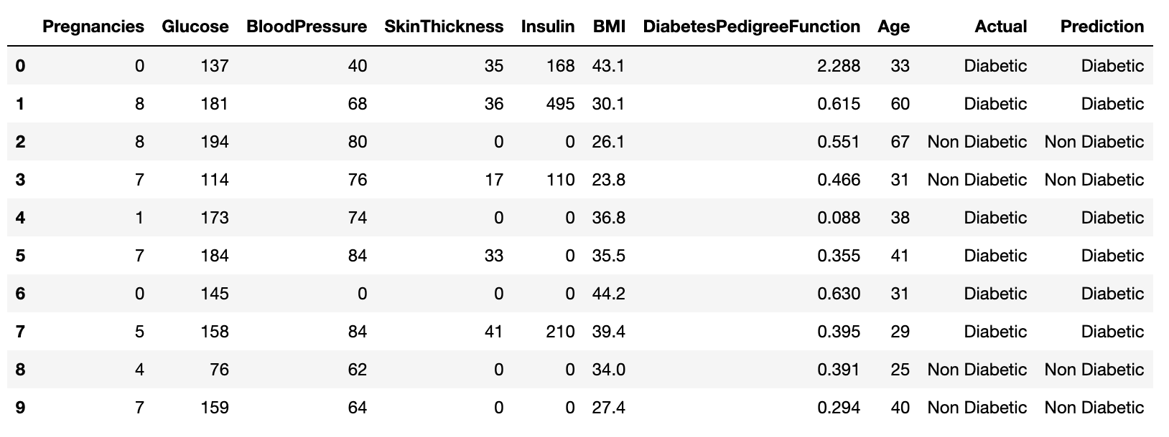
csv file for our model

Slide 8
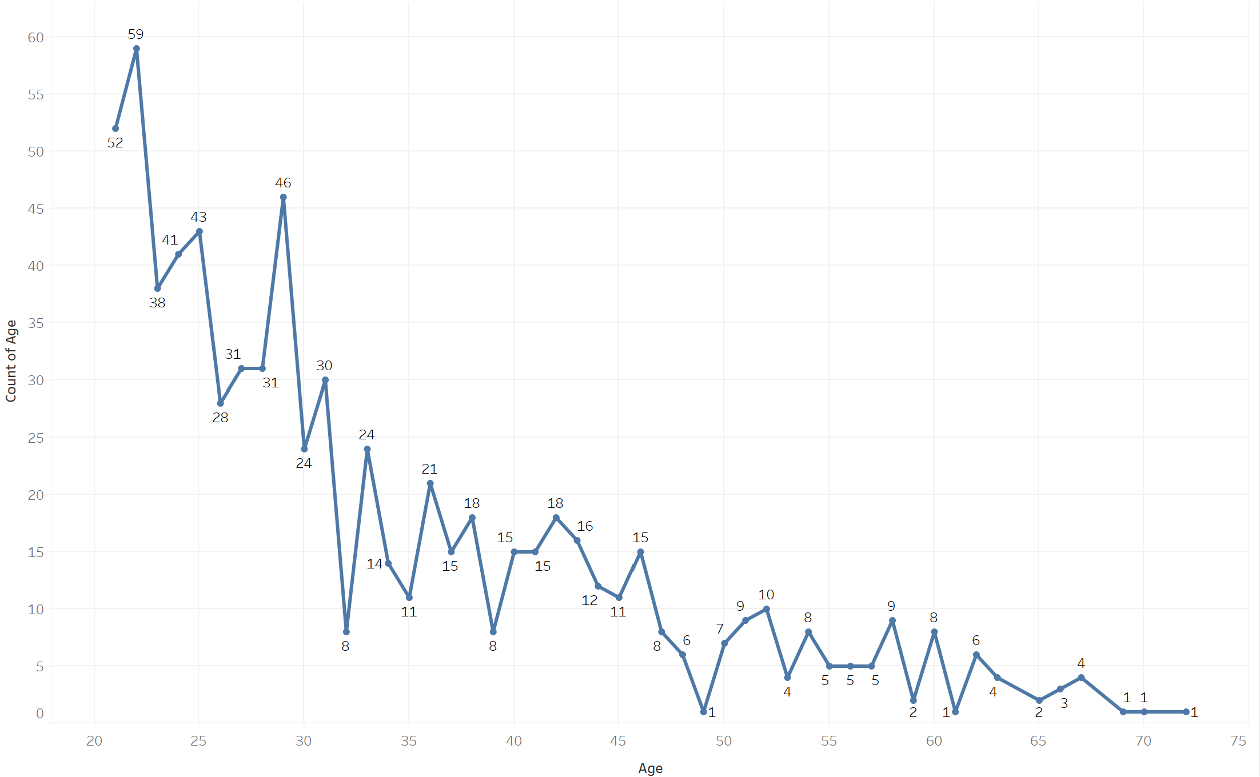
Age of Sample Size
The age of our sample ranged from 21 to 72 years old. The majority of our sample fell between 21 and 36 years old, with the highest number of individuals being 22 and 29 years old.

Slide 9
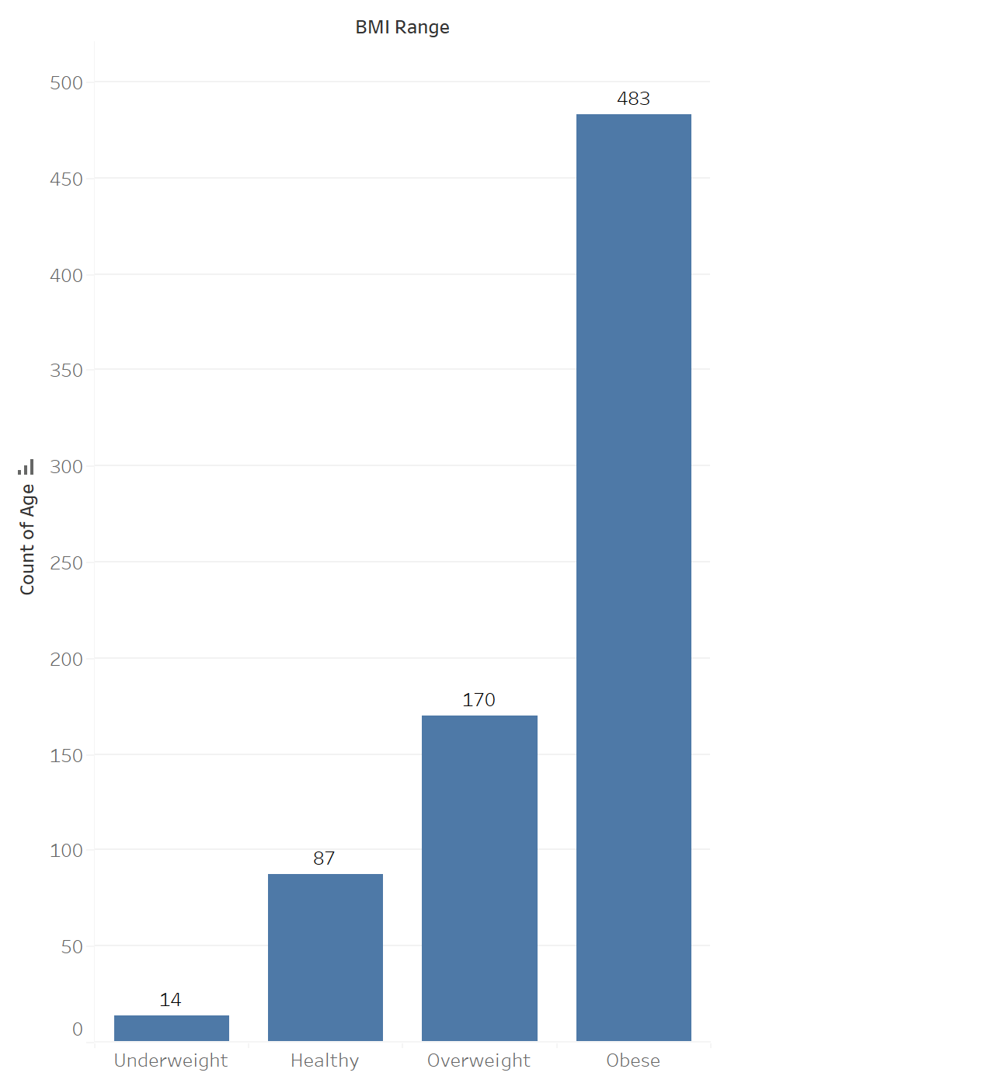
Body Mass Index (BM)
The Body Mass Index (BMI) was broken into 4 different categories; Underweight (<18.5), Healthy (>=18.5 – 25), Overweight (25 – 30), and Obese (>30).

Slide 10
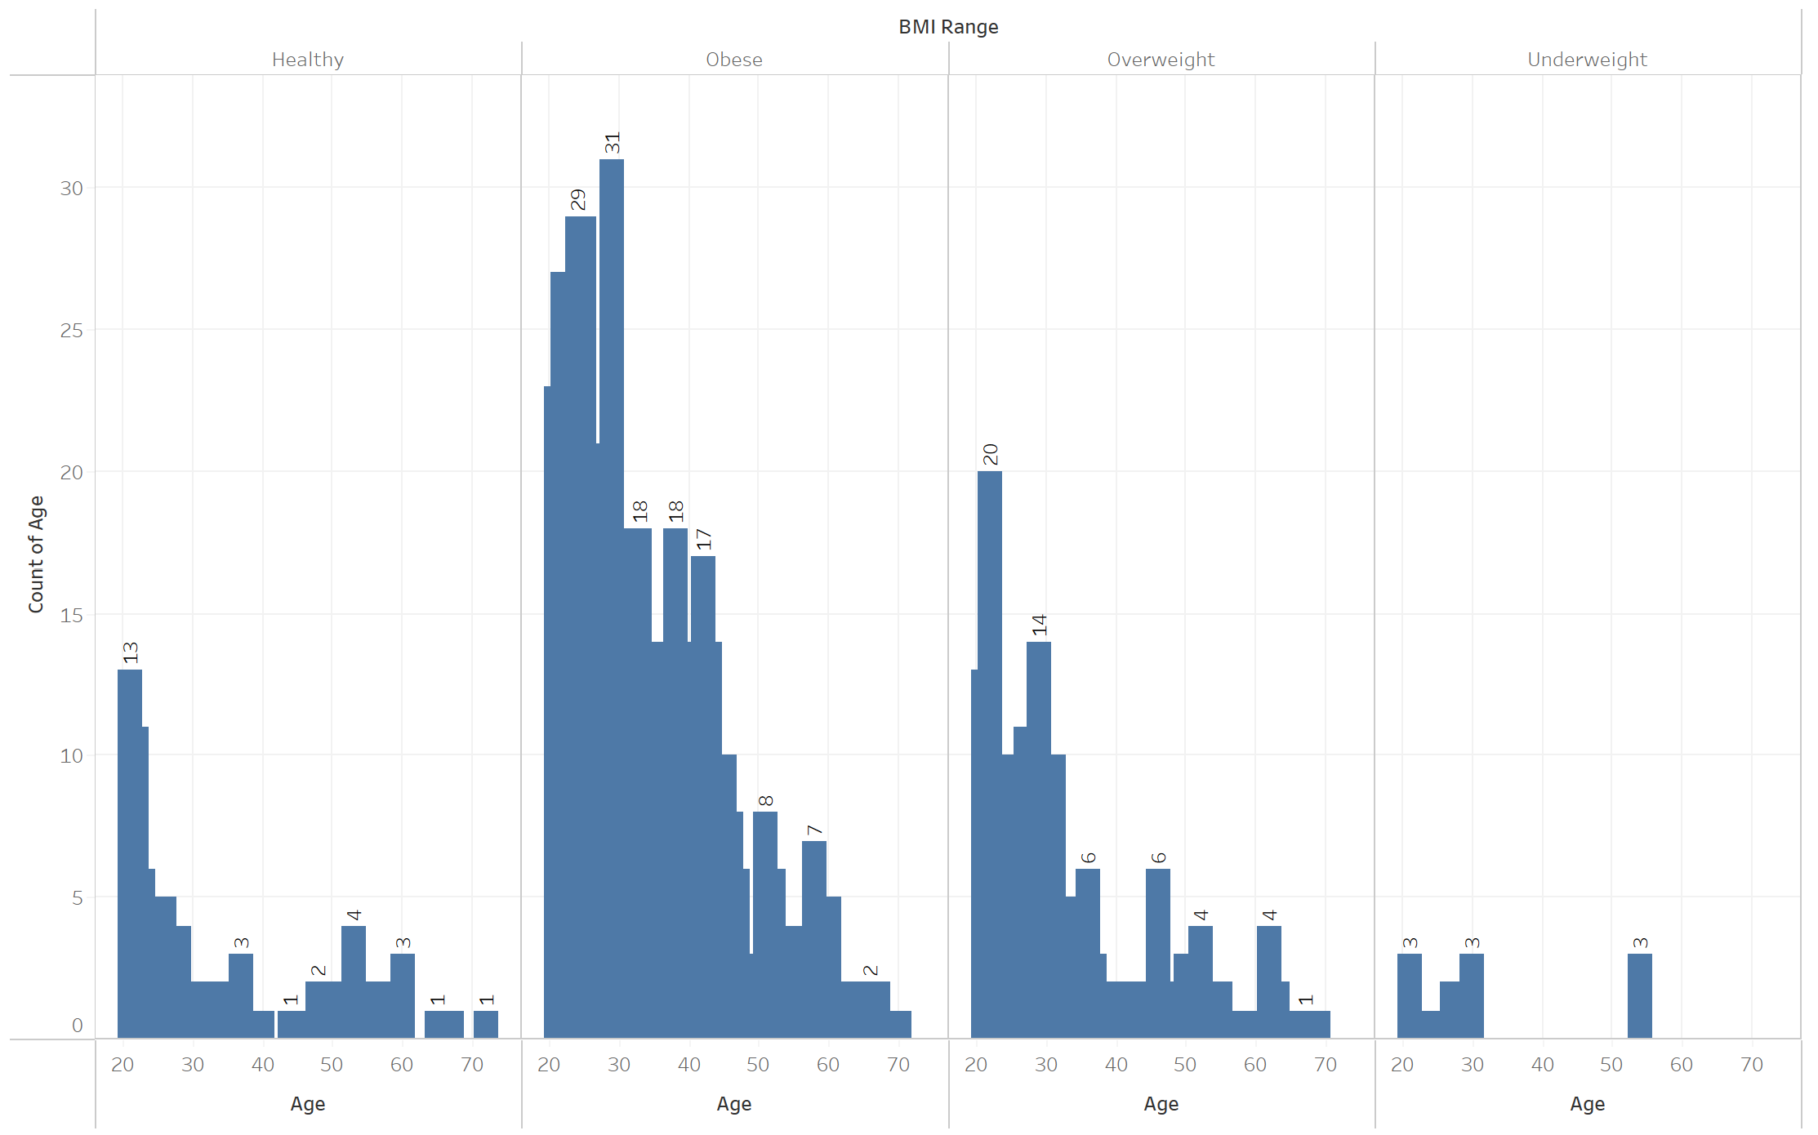
Age by BMI
The majority of our sample were considered Obese. The majority of individuals were between 20 and 30 years old.

Slide 11
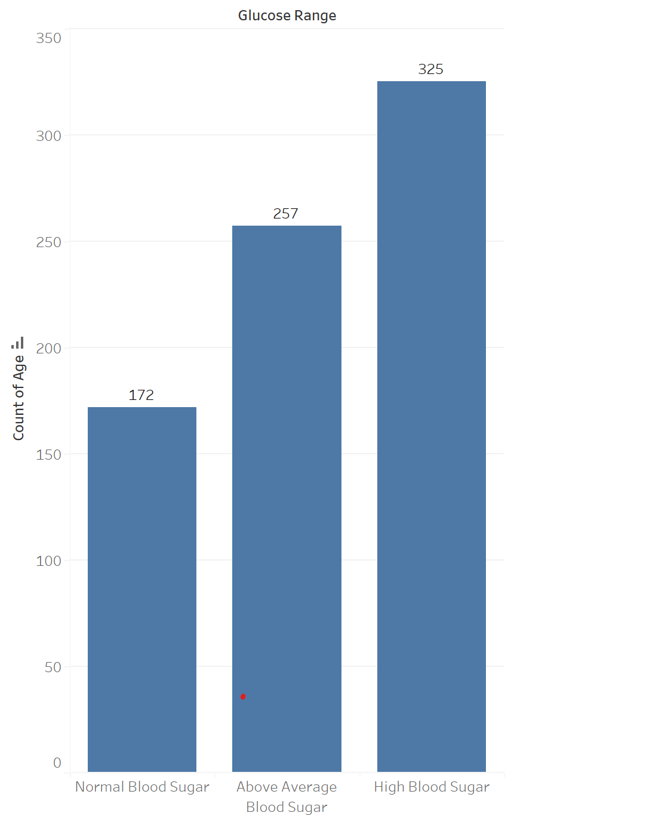
Glucose Levels
Next, we looked at where our sample’s glucose level fell. This was broken into 3 categories; Normal Blood Sugar (<= 100), Above Average Blood Sugar (100 - >=125), and High Blood Sugar (>=126).

Slide 12
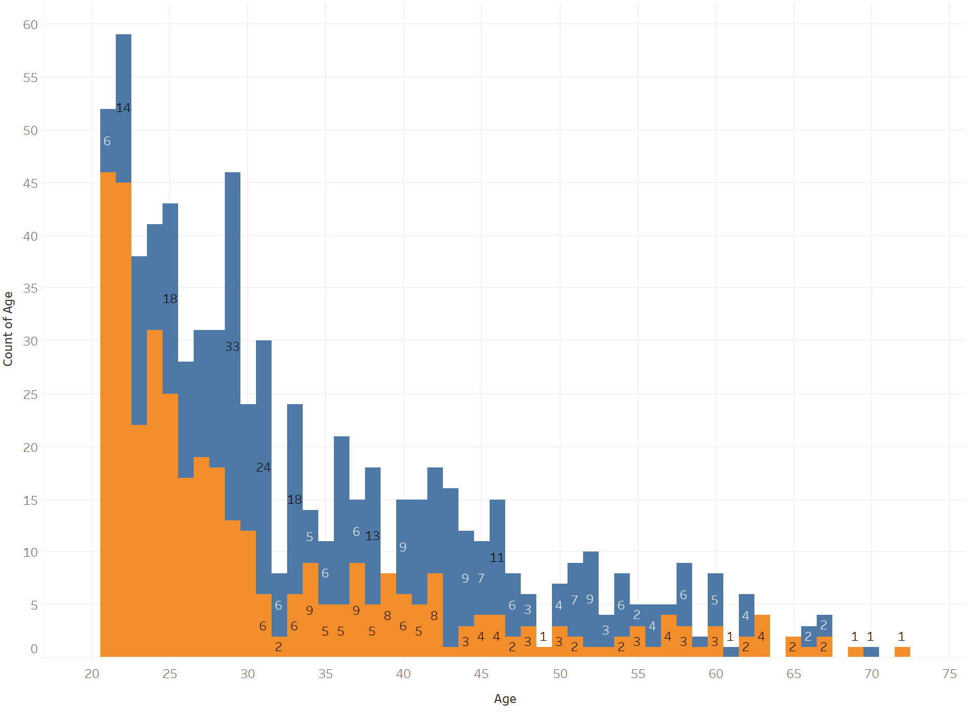
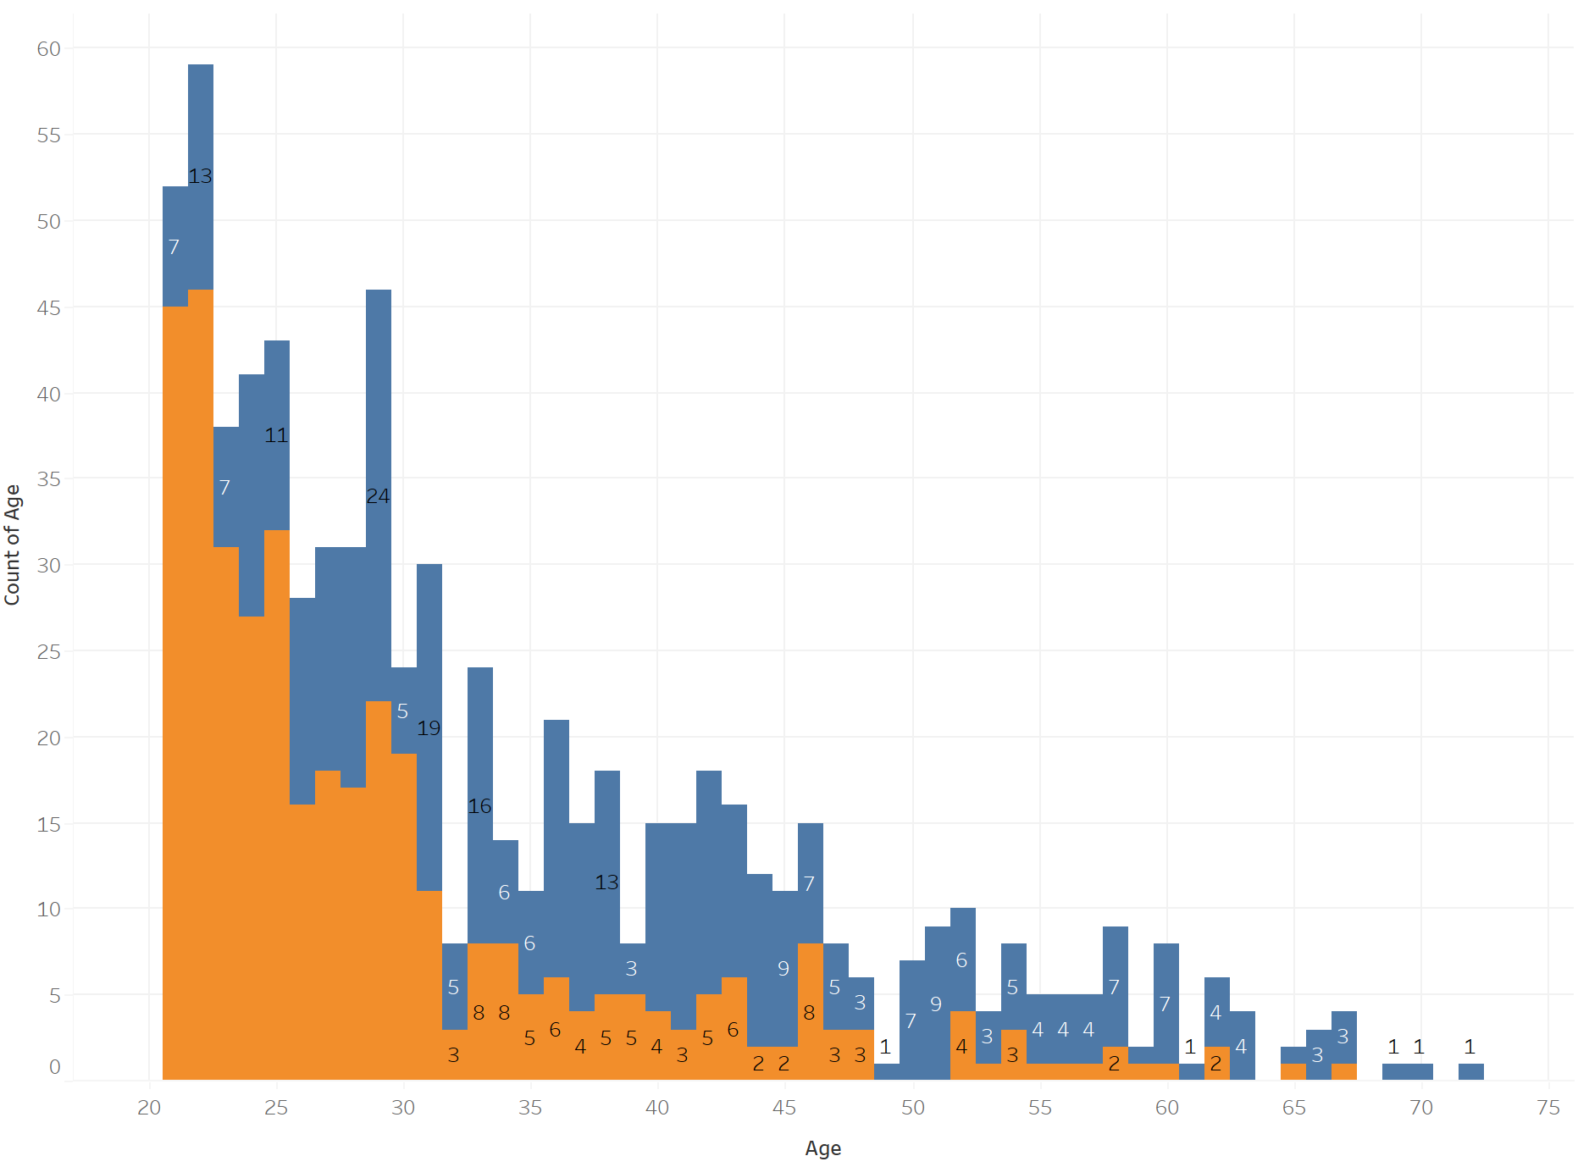
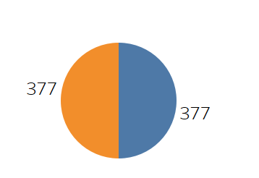
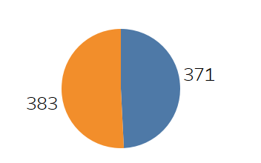

Outcome – Logistic Regression Model
Age Outcome – Oversample Model
Actual
Prediction
Actual
Prediction
Our actual results is a 50-50 split. Our oversample model had a 74% accuracy.

Slide 13
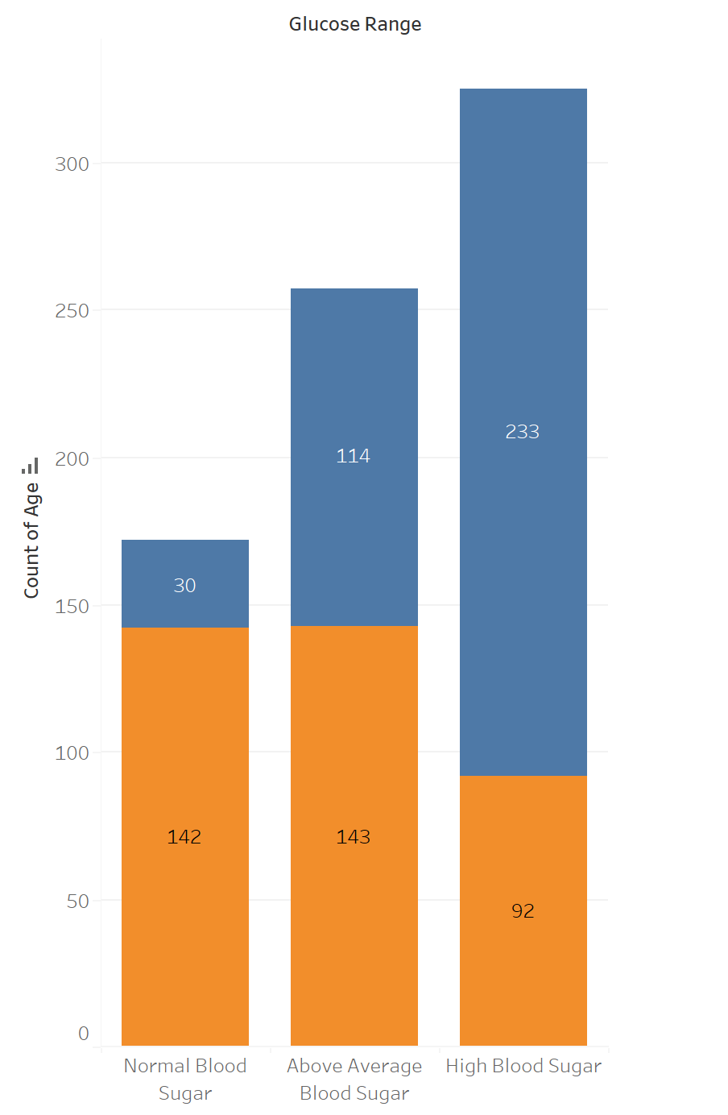
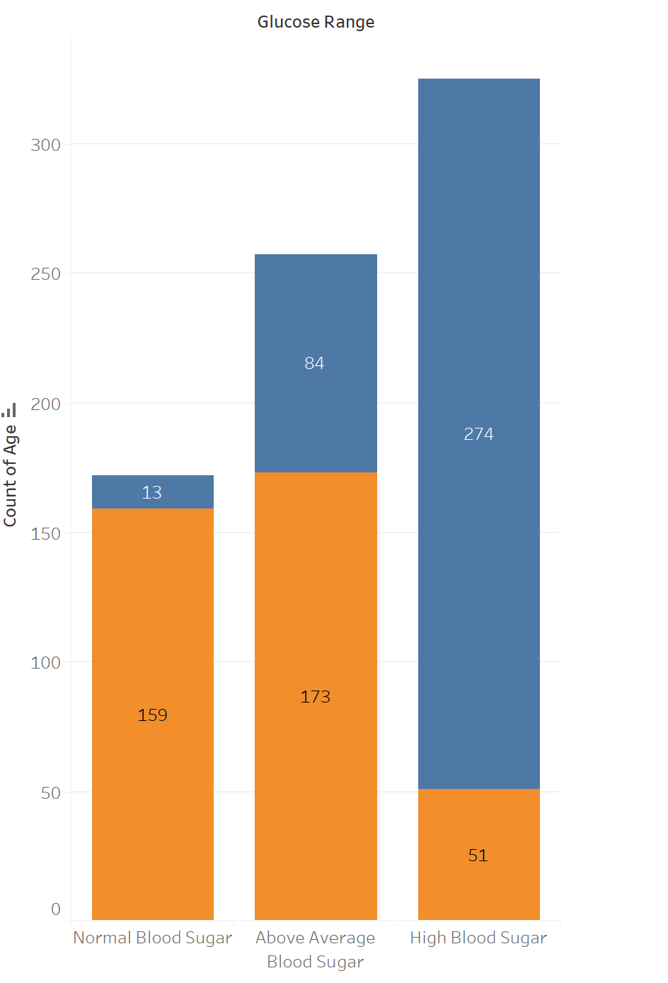
Glucose Outcome – Oversample Model
Age Outcome – Logistic Regression Model
Outcome – Oversample Model
Actual
Prediction
Actual
Prediction
Actual
Prediction
Our actual results is a 50-50 split. Our oversample model had a 74% accuracy.

Slide 14
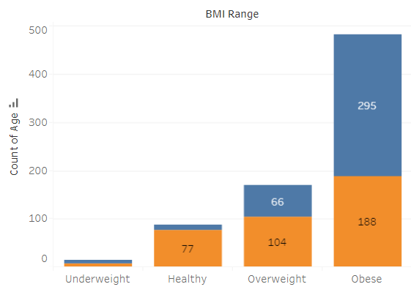
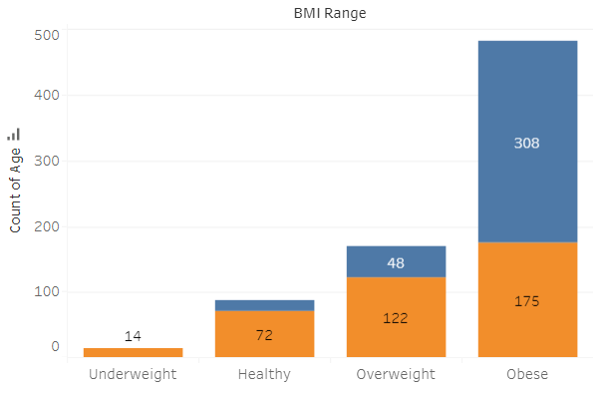
Body Mass Index Outcome – Logistic Regression Model
Glucose Outcome – Logistic Regression Model
Age Outcome – Oversample Model
Actual
Prediction
Actual
Prediction
Actual
Prediction

Slide 15
Glucose Outcome – Logistic Regression Model
Body Mass Index Outcome – Logistic Regression Model
Actual
Prediction
Actual
Prediction

Slide 16
Body Mass Index Outcome – Logistic Regression Model
Actual
Prediction

Slide 17
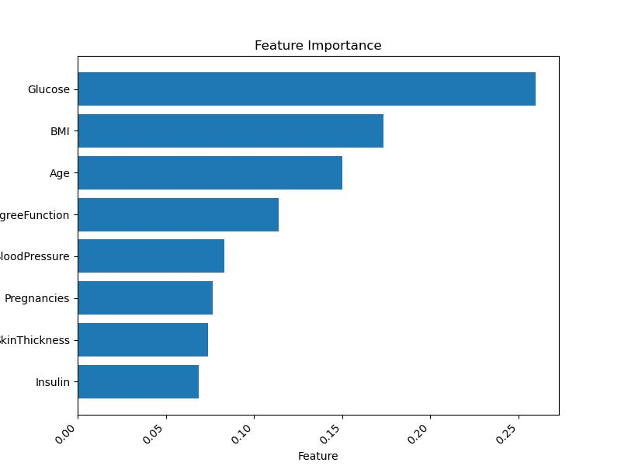
Random Forest Model
Combines the output of multiple decision trees to reach a single result.
Addresses both classification and regression problems.

Slide 18
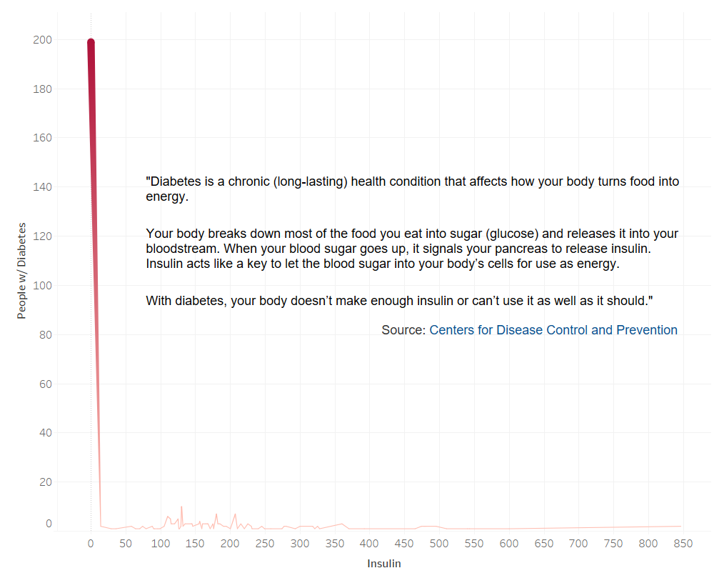

Slide 19
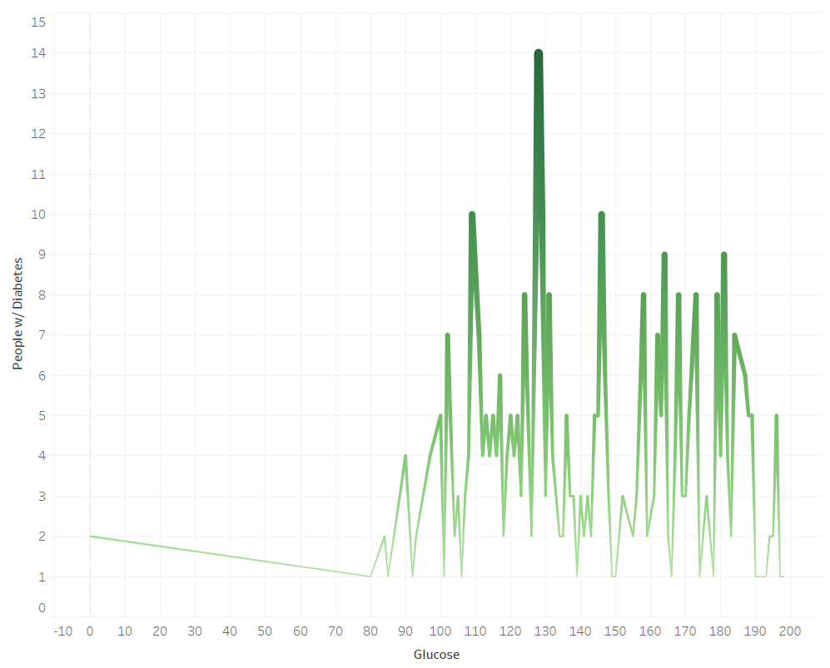

Slide 20
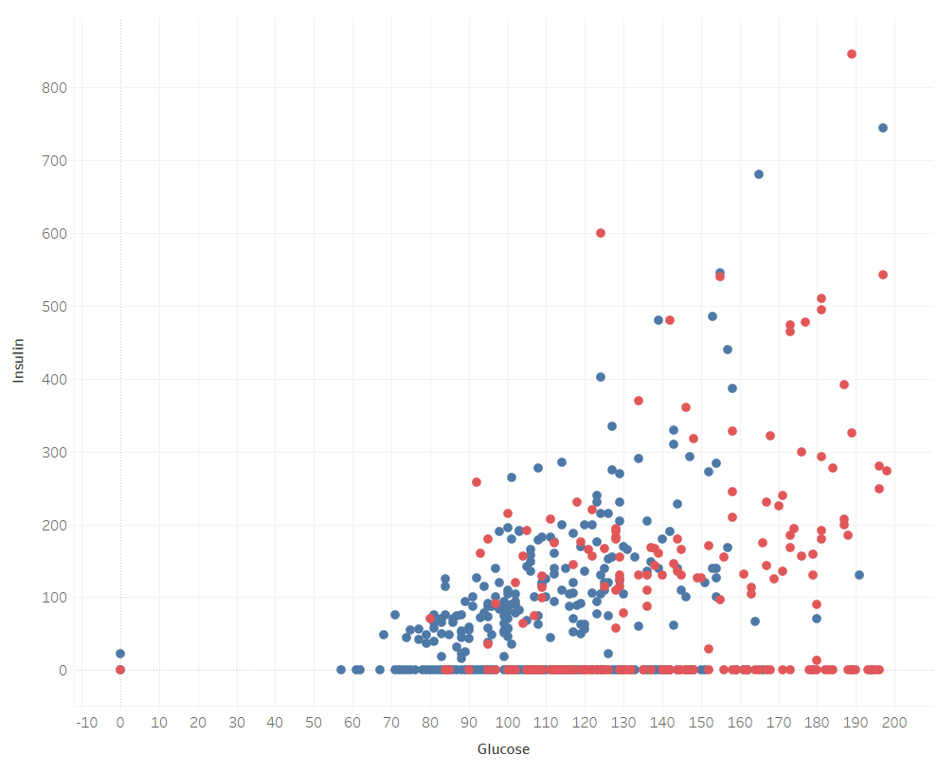

Slide 21
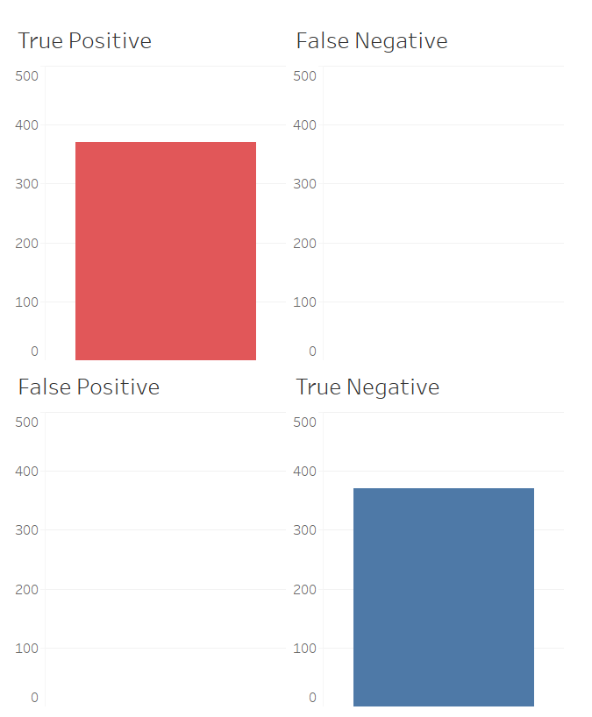

Slide 22
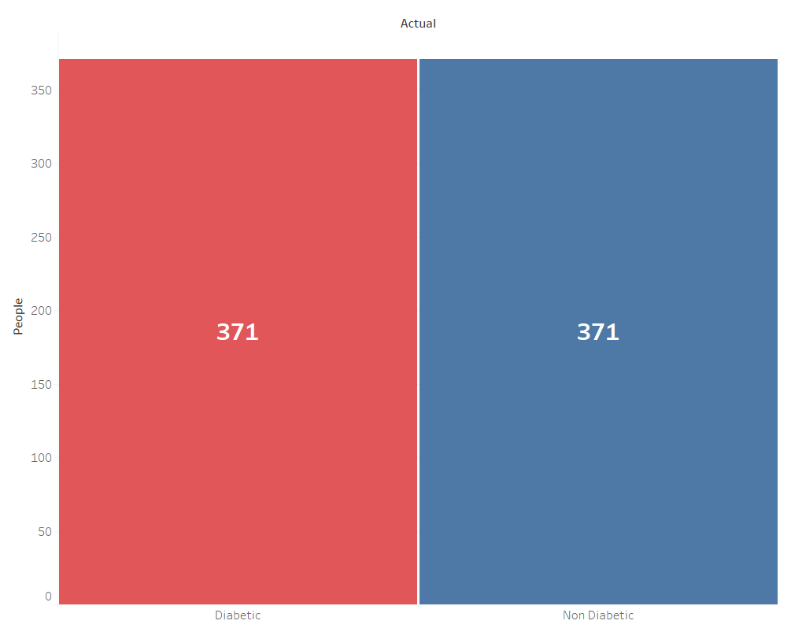

Slide 23
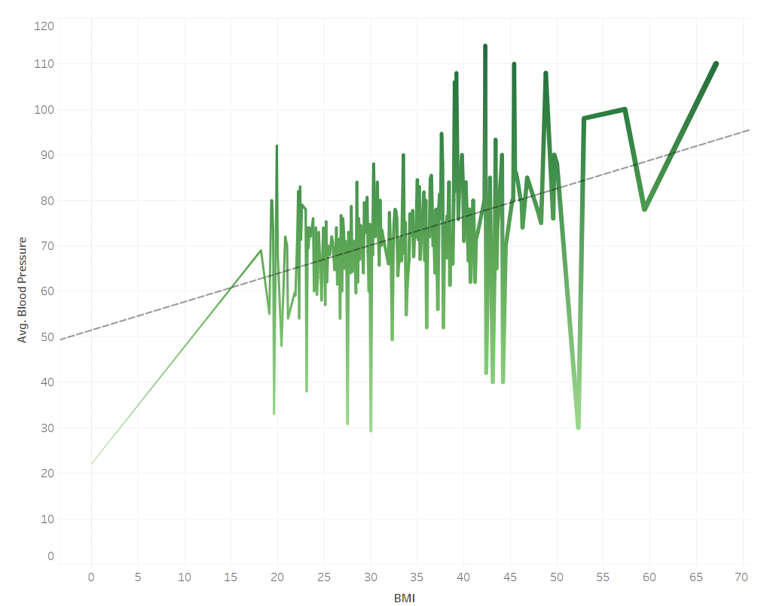

Slide 24
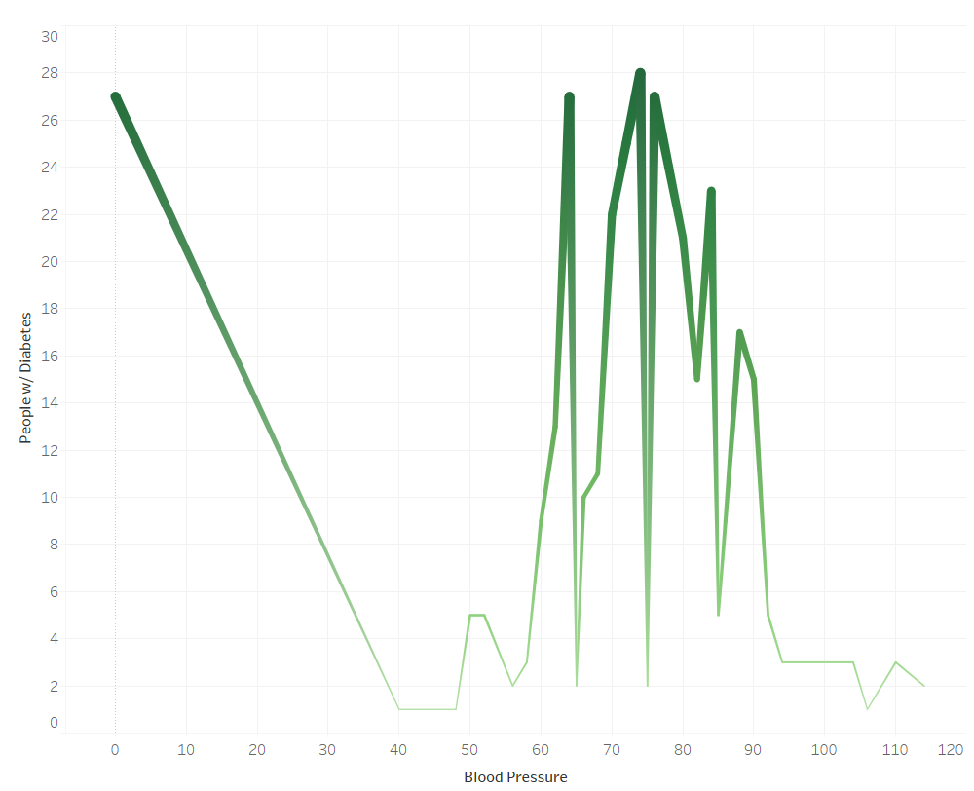

Slide 25
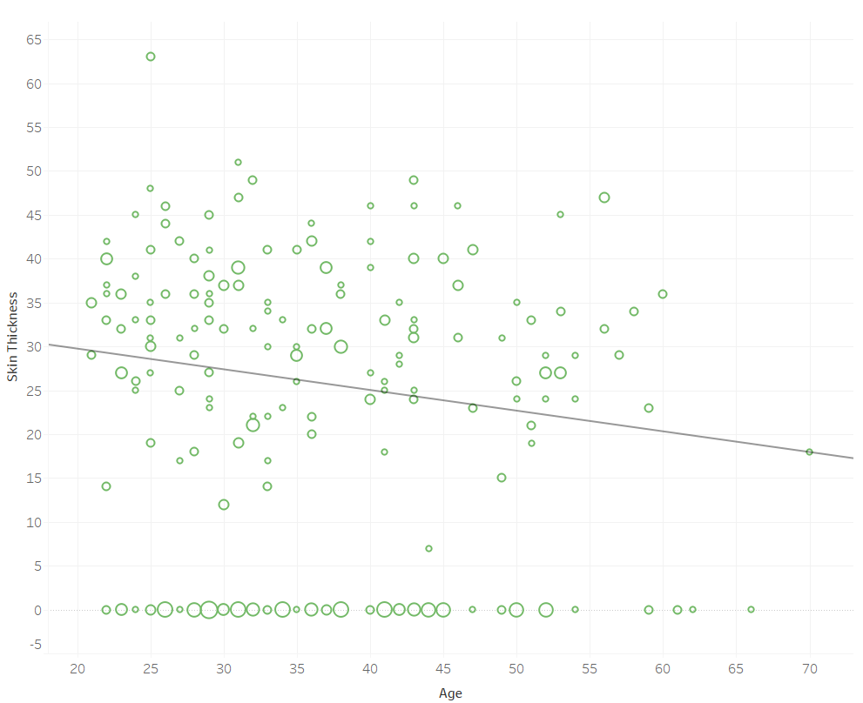

Slide 26
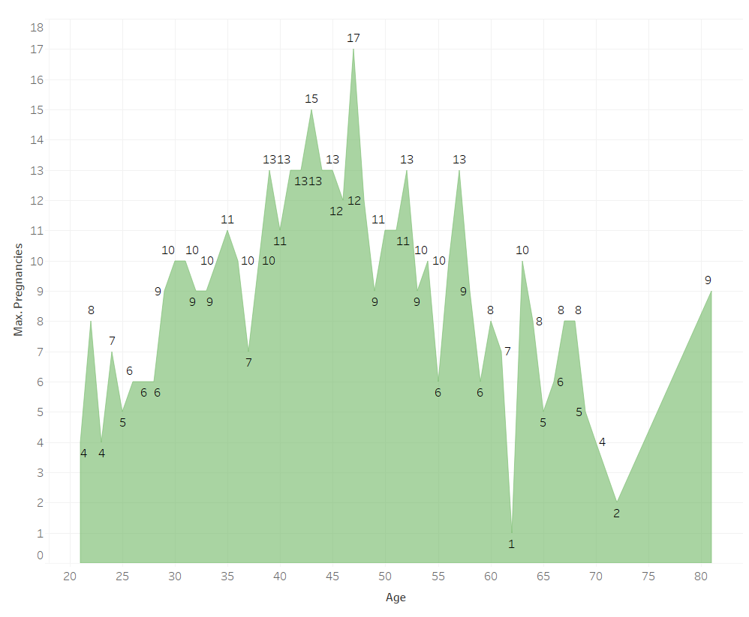

Slide 30

Summary
The Random Forest Model was ideal to predict our diabetes dataset. We produced an initial model and made edits to it in order to optimize the accuracy score.
Our model achieved an accuracy score of 1.0, recall of 1.0, precision of 1.0, and f1-score of 1.0.
The three most important features from our dataset, according to the feature_importances_, are 1. glucose 2. BMI, 3. Age.
While our model is able to predict with 100% accuracy this is due to the limitation that our sample size is small. Our data is comprised of 768 rows of data (females only) with 8 measurable variables and 1 outcome. We would benefit from inputting a larger dataset with both genders.

